Slide 1
The Digital Provide: Information (Technology), Market Performance, and Welfare in the South Indian Fisheries Sector
By Robert Jensen
Discussion by Jeff Denning

Slide 2
Question
What happens when you give fisherman cell phones?
The “Law of One Price” says that prices should be equal across markets (after accounting for transport costs)
Does technology help with the diffusion of information? Does it help fisherman in developing contexts?
What is the effect of technology on the *dispersion* of prices

Slide 3
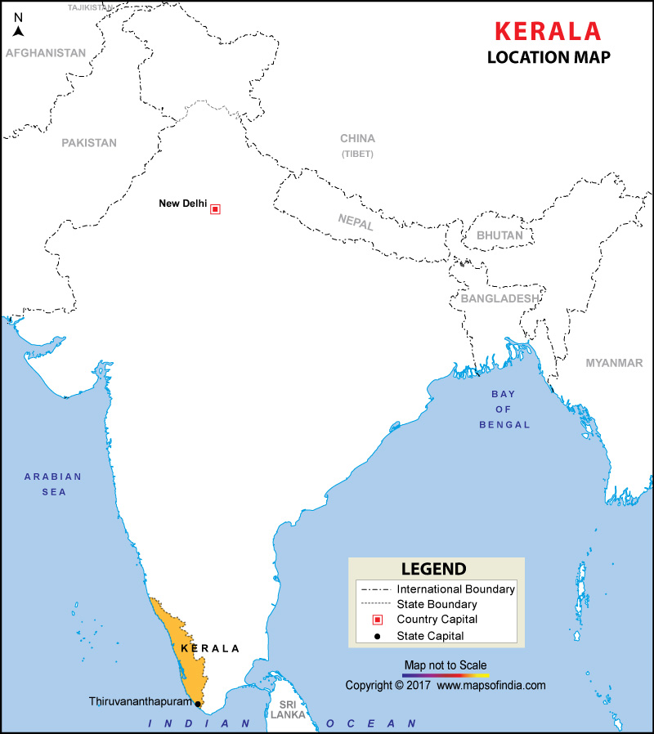
Kerala India

Slide 4
Setting
Fishing is important--70% of adults eat fish at least 1x a day
1 million people employed in fishing
Many ports where they can sell their fish
However, the market is open for 3 hours and so fisherman can only go to 1

Slide 5
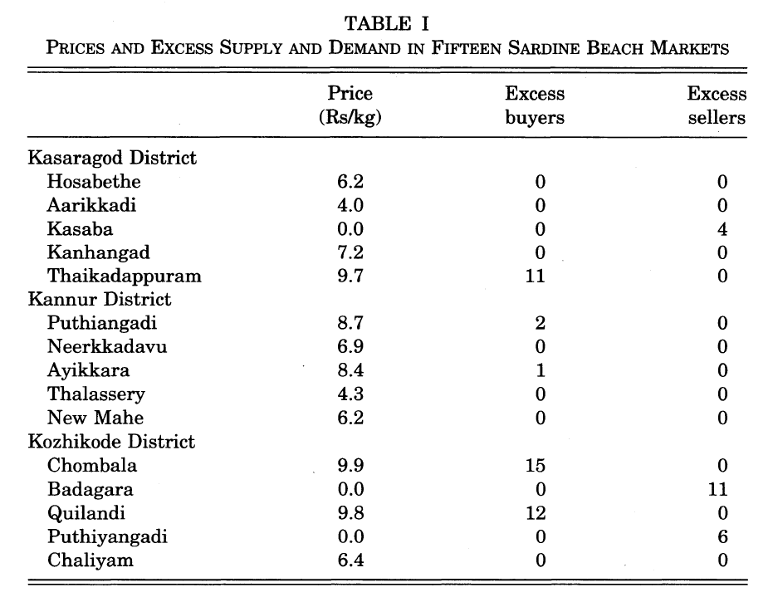
Law of One Price Doesn’t Really Hold

Slide 6
Background
Mobile phone service is introduced in 1997 gradually.
By 2001, 60% of fishing boats were using phones to communicate
Focus on Kasaragod, Kannur, and Kozhikode

Slide 7
Data
Survey of 300 sardine fishing boats (“units”)
Every Tuesday from Sept 3, 1996 to May 29, 2001
They focus on 15/35 ports

Slide 8
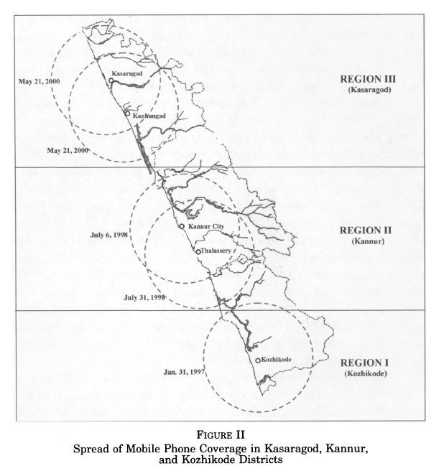
Cell Service Roll Out was Staggered

Slide 9
Why is Interrupted Time Series appropriate/What would be a problem?
Must assume that fisherman don’t change behavior in anticipation
Would this be easy to do? (They’d probably have to move)
The effect of treatment should be immediate
Did something else change at the same time?
Timing is as good as random?
What if cell service was added when there was very fast economic growth?

Slide 10
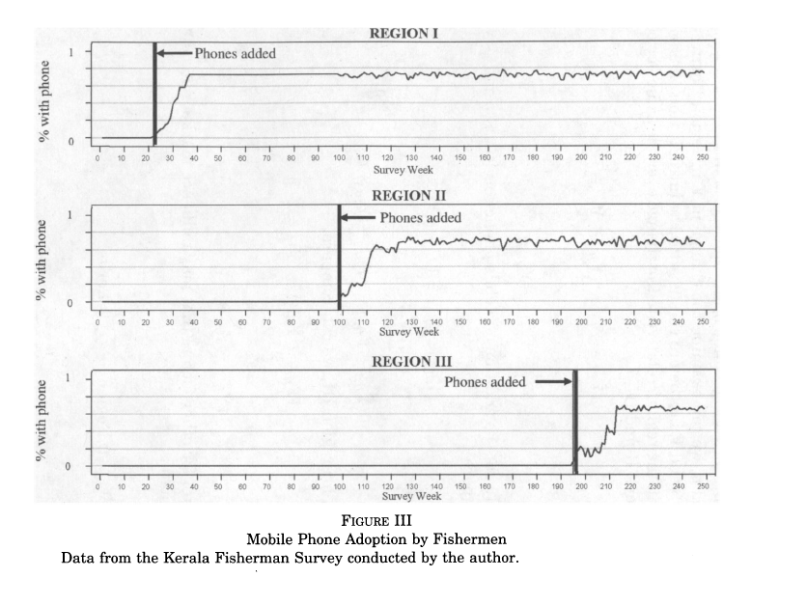
Percent of Fisherman with a phone

Slide 11
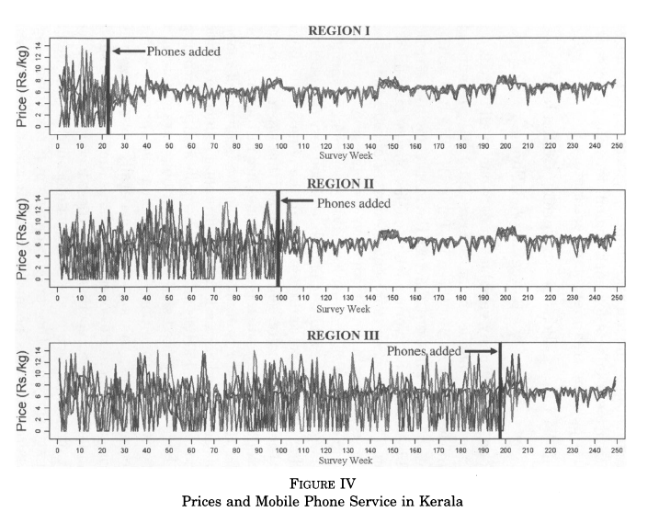
Interrupted Time Series Figures

Slide 12
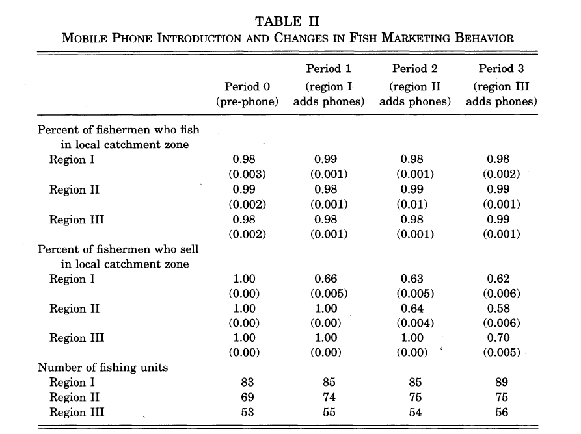
Cell phones changed where fisherman sold their fish

Slide 13
Estimation
Actually not implemented as an interrupted time series
He uses a differences in differences comparing the treated regions to not-yet-treated or already treated
This is pretty common--people often use another difference

Slide 14
Summary
Interrupted Time Series can be nice if treatment has an immediate effect
Also, if units can’t choose when to be treated

